Slide 1


Microbial Nutrition and Culture of bacteria
Lecture 5
Prof. Dr. Munira Ch. Ismaeel
Ass. Prof. Dr. Israa AJ Ibrahim

Slide 2

Microbial Nutrition and Culture of bacteria Lec.5
Prof. Dr. Munira Ch. Ismaeel and Ass. Prof. Dr. Israa AJ Ibrahim

Slide 3
Microbial Nutrition
All living organisms, from micro to macroorganisms require nutrients for growth and normal functioning.
All organisms require water, elements, and energy. The elemental components are carbon, nitrogen, phosphorus, sulphur and potassium besides hydrogen and oxygen major ones for synthesizing cellular components. The energy is derived from the chemical compounds or radiant energy like light.

Slide 4
Microbial growth requirements
The requirements for growth
Physical requirements | Chemical requirements (nutritional factors)
- pH - Temperature -oxygen -osmotic pressure | -Carbon -nitrogen, sulfur, phosphorous -trace elements -organic growth factor

Slide 5
Physical factors requirements for bacterial growth
pH
-Optimum pH: the pH at which the microorganism grows best (eg. pH 7).
-most bacteria grow between pH 6.5 and 7.5
-molds and yeasts grow between pH 5 and 6
-According to their tolerance for acidity alkalinity, bacteria are classified as:
Acidophiles (acid-loving): grow best at pH 0.1-5.4
Neutrophiles: grow best at pH 5.4 to 8.0
Alkaliphiles: (base-loving): grow best at pH 7.0-11.5

Slide 6
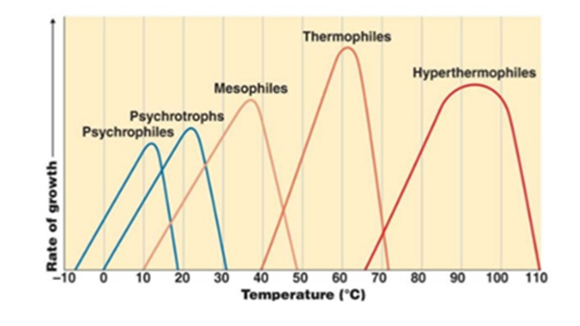
Physical factors requirements for bacterial growth
Temperature
According to their growth temperature range, bacteria can be classified as:
Psychrophiles: grow best at 15- 20 OC
Psychrotrophs: grow best 0oC and 20-30 OC
Mesophiles: grow best at 25-40 OC
Thermophiles: grow best at 50-60 OC

Slide 7
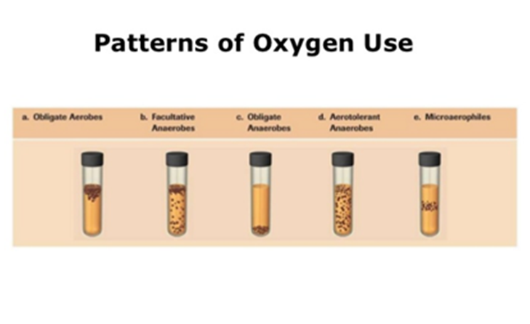
Physical factors requirements for bacterial growth
Oxygen
- Aerobes: require oxygen to grow
- Obligate aerobes: must have free oxygen for aerobic respiration (e.g. Pseudomonas)
- Anaerobes: do not require oxygen to grow
- Obligate anaerobes: killed by free oxygen (e.g. Bacteroides)
- Microaerophiles: grow best in presence of small amount of free oxygen
- Capnophiles: carbon-dioxide loving organisms that thrive under conditions of low oxygen
- Facultative anaerobes: carry on aerobic metabolism when oxygen is present, but shift to anaerobic metabolism when oxygen is absent
- Aerotolerant anaerobes: can survive in the presence of oxygen but do not use it in their metabolism

Slide 8
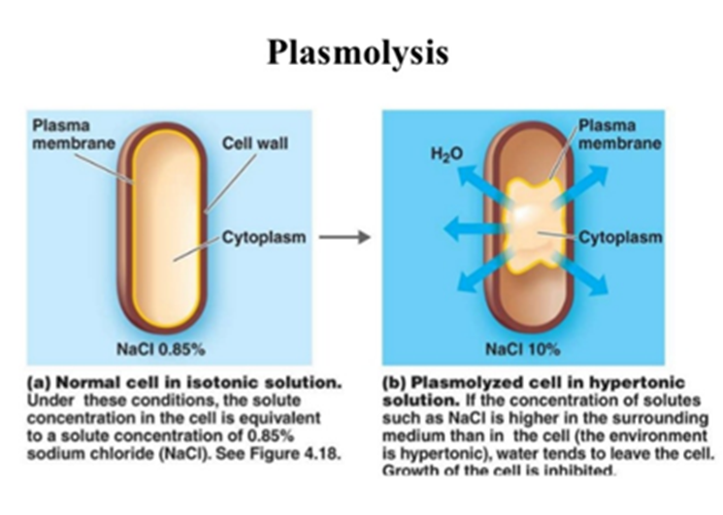
Physical factors requirements for bacterial growth
Osmotic Pressure
- Environments that contain dissolved substances exert osmotic pressure, and pressure can exceed that exerted by dissolved substances in cells
- Hyperosmotic environments: cells lose water and undergo plasmolysis (shrinking of cell)
- Hypoosmotic environment: cells gain water and swell and burst

Slide 9
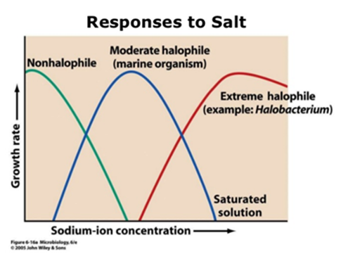
Physical factors requirements for bacterial growth
Halophiles
Salt-loving organisms which require moderate to large quantities of salt (sodium chloride)
Membrane transport systems actively transport sodium ions out of cells and concentrate potassium ions inside
Why do halophiles require sodium?
1) Cells need sodium to maintain a high intracellular potassium concentration for enzymatic function
2) Cells need sodium to maintain the integrity of their cell walls

Slide 10
Chemical Requirement: Nutritional Factors are
1- Carbon sources
2- Nitrogen
3- Sulfur and phosphorus
4- Trace elements (e.g. copper, iron, zinc, and cobalt)
5- Vitamins (e.g. folic acid, vitamin B-12, vitamin K)

Slide 11
Chemical Requirements
Carbon sources
The carbon requirements of organisms must be met by organic carbon (a chemical compound with a carbon-hydrogen bond) or by CO2. Organisms that use organic carbon are heterotrophs and organisms that use CO2 as a sole source of carbon for growth are called autotrophs. All living organisms require a source of energy. Organisms that use radiant energy (light) are called phototrophs. Organisms that use (oxidize) an organic form of carbon are called heterotrophs or (chemo) heterotrophs. Organisms that oxidize inorganic compounds are called lithotrophs.

Slide 12
Major nutritional types of procaryotes and eucaryotes
Nutritional Type | Energy Source | Carbon Source | Examples
Photoautotrophs | Light | CO₂ | Cyanobacteria, some Purple and Green Bacteria, plant, algae.
Photoheterotrophs | Light | Organic compounds | Some Purple and Green Bacteria
Chemoautotrophs or Lithotrophs (Lithoautotrophs) | Inorganic compounds, e.g. H₂, NH₃, NO₂, H₂S | CO₂ | A few Bacteria and many Archaea.
Chemoheterotrophs or Heterotrophs | Organic compounds | Organic compounds | Most Bacteria, some Archaea animals, protozoa, fungi.

Slide 13
Chemical Requirements
Nitrogen
Found in amino acids and proteins
Most bacteria decompose proteins
Some bacteria use Ammonium NH4+ or nitrate NO3-
A few bacteria use N2 in nitrogen fixation
Sulfur
Found in amino acids, thiamine, and biotin
Most bacteria decompose proteins
Some bacteria use Sulfate ion SO42- or Hydrogen sulfide H2S

Slide 14
Chemical Requirements
Phosphorus
Found in DNA, RNA, ATP, and membranes
Phosphate PO43- is a source of phosphorus
Trace elements
Inorganic elements (mineral) required in small amounts
Usually as enzyme cofactors
Ex: iron, molybdenum, zinc
Organic Growth Factors
Organic compounds obtained directly from the environment
Ex: vitamins, amino acids, purines, and pyrimidines

Slide 15
Types of Culture Media
Synthetic medium: Medium prepared in the laboratory from material of precise or reasonably well-defined composition
Complex medium: Medium contains reasonably familiar material but varies slightly in chemical composition from batch to batch (e.g. peptone, a product of enzyme digestion of proteins)

Slide 16
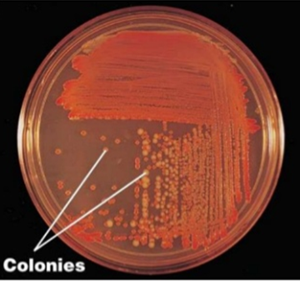
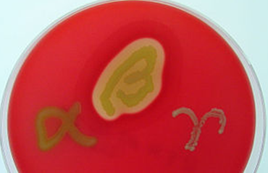
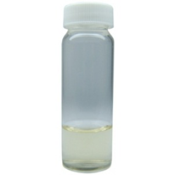
Selective, Differential, and Enrichment Media
Selective medium: Medium encourages growth of some
organisms but suppresses growth of others (e.g. MacConkey agar)
Differential medium: Medium contains a constituent
that causes an observable change (e.g. Blood agar)
Hemolyses of Streptococcus spp. (left) α-hemolysis
(S. mitis); (middle) β-hemolysis (S. pyogenes); (right) γ-hemolysis
(= nonhemolytic, S. salivarius)
Enrichment medium: Medium contains special nutrients that allow growth of a particular organism over others (e.g. Alkaline Peptone Water is used for the cultivation of vibrio)

